Slide 1
UMD Data Challenge
Veoride Trends: 2019 vs 2020
Team Members: Miranda Clay, June Tian
Mentor: Ruchira

Slide 2
Introduction to the Data
Veoride dataset
Included over 40k entries of individual rides in October 2019 and October 2020
Columns that we focused on in our analysis:
Distance traveled
Number of minutes
Coordinate location data

Slide 3
Our Approach
Programs we used in our analysis:
Excel
R
QGIS
By generating graphs and conducting statistical tests, we were able to answer the following questions:
Were there differences in the number of rides between 2019 and 2020?
Was there a significant difference in average travel distance between 2019 and 2020?
Was there a significant difference in average minutes per ride between 2019 and 2020?
What are the most popular starting and ending locations?

Slide 4
Challenges Faced
Geocoding was a new territory for us, but we were able to figure out how to use new programs and software
Because of how detailed the problem statement was, we decided to focus our analysis on what we saw as within our scope

Slide 5
Results

Slide 6
Comparison between 2019 and 2020 - Number of Rides
October 2019 October 2020
Total Rides: 17,662 21,215
Average Rides Per Customer: 5.603 6.582
Both the number of total rides and the average number of rides per customer in the month of October have increased in 2020.

Slide 7
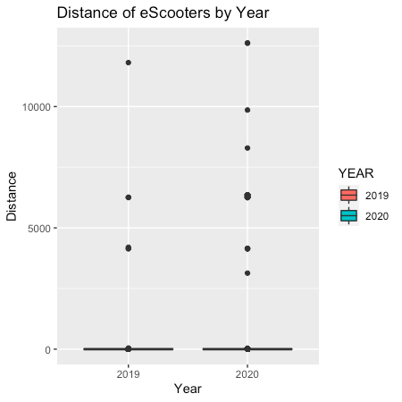
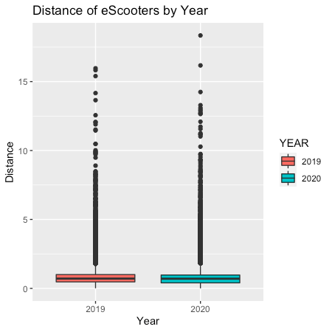
Comparison between 2019 and 2020 - Distance Traveled
After shortening the distance range -->
Distance < 20

Slide 8

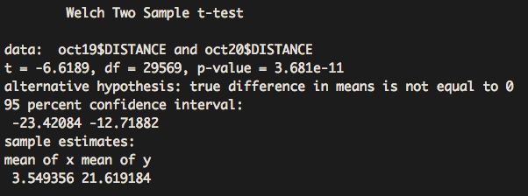
Comparison between 2019 and 2020 - Distance Traveled
Summary statistics of 2019 distance data:
Summary statistics of 2020 distance data:
Conduct a t-test to see if difference in means is statistically significant
Conclusion: the average distance traveled between Oct. 2019 and Oct. 2020 are significantly different, but the spread of data could be affecting the means

Slide 9
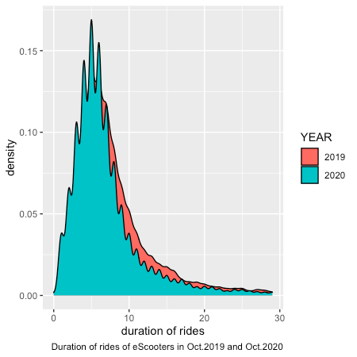
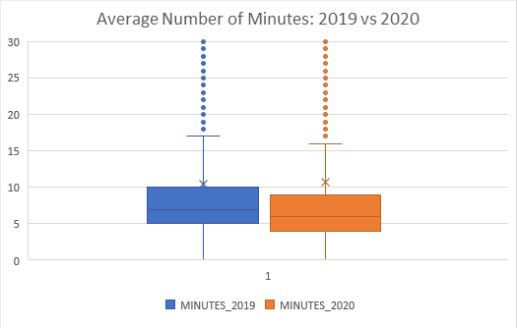
Comparison between 2019 and 2020 - Duration of Rides
It appears that there may be a slight decrease in ride durations in 2020, we will check to see if this is significant.

Slide 10


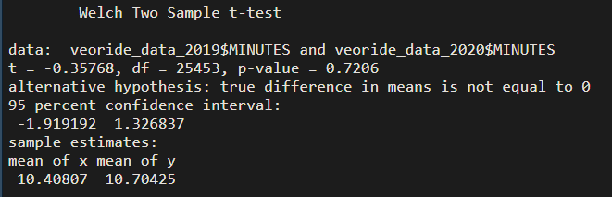
Comparison between 2019 and 2020 - Duration of Rides
Summary statistics for 2019 number of minutes:
Summary statistics for 2020 number of minutes:
Conduct a t-test to see if difference in means is statistically significant
Conclusion: the average duration of rides between Oct. 2019 and Oct. 2020 are not significantly different

Slide 11
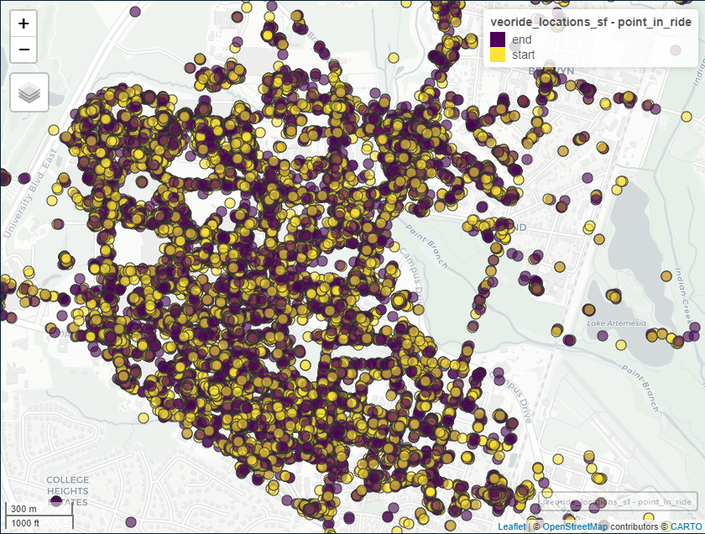
Coordinate Mapping to Determine Most Popular Locations
Using a library in R called mapview, generated a map showing all start and end coordinates in the dataset
Difficult to draw conclusions from this map
Using a software called QGIS, generated heat maps

Slide 12
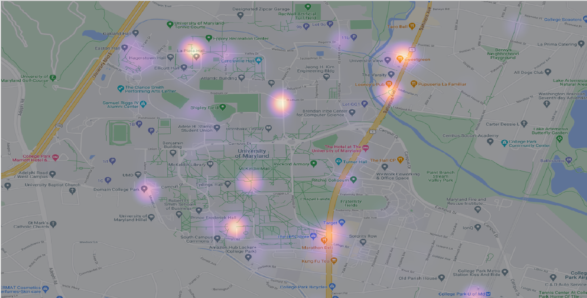
Heat Map of Starting Points

Slide 13
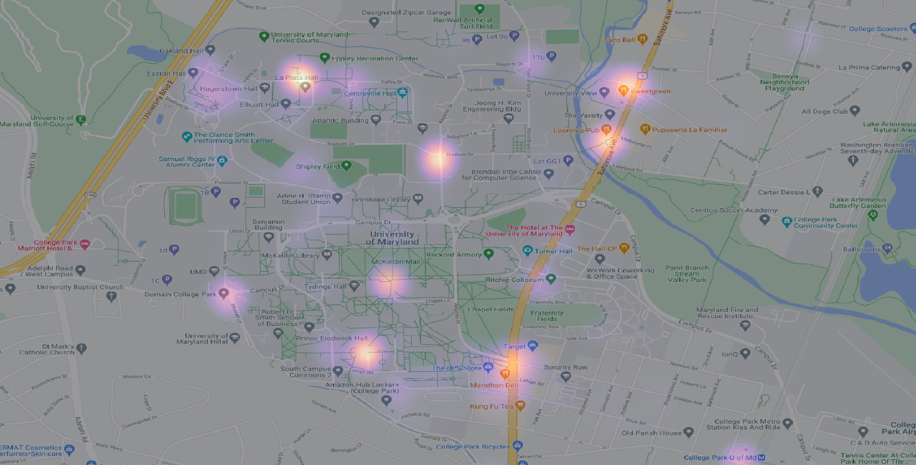
Heat Map of Ending Points

Slide 14
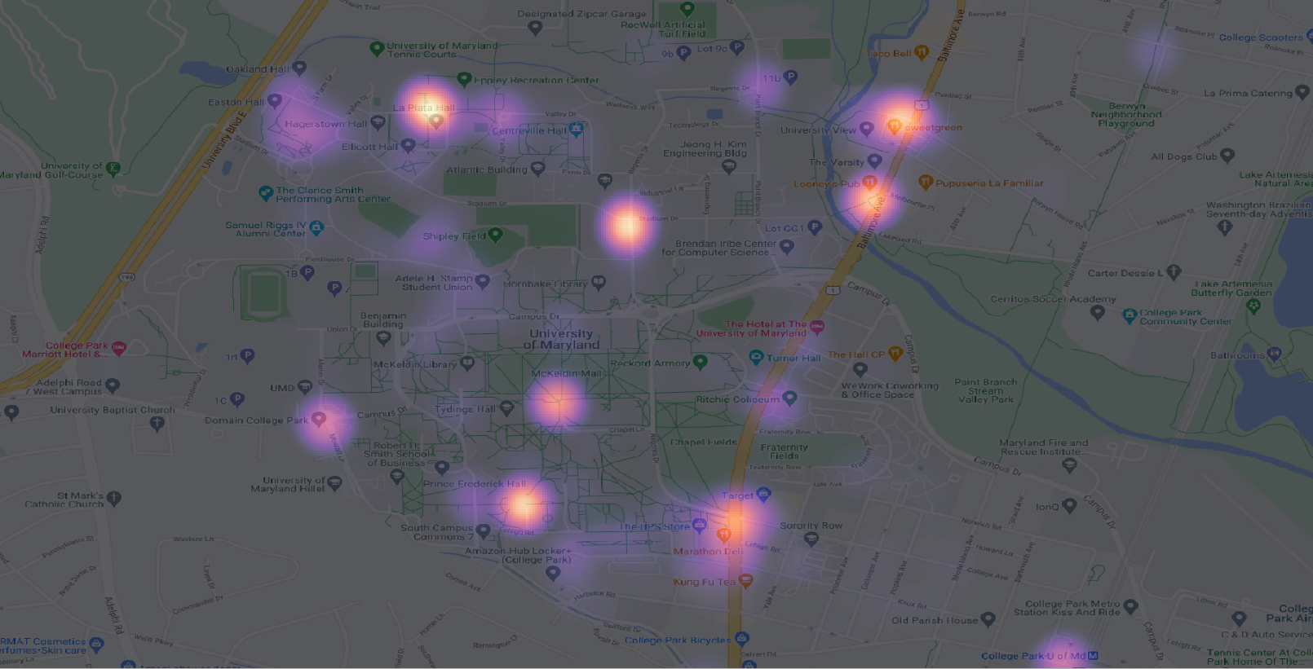
Combined Heatmap of Starting and Ending Points
Because the resulting heatmaps were so similar, we can combine them to determine which points are the most popular for both starting and ending.

Slide 15
Top 7 Most Popular Starting and End Points
Eppley Recreation Center
UMD Department of Transportation services
The Varsity Apartments
Cypress Building (close to The View)
Susquehanna hall (close to south commons)
Francis Scott Key Hall
Target

Slide 16
Overall Conclusions
While the average distance of rides in October 2020 is greater, the distances in this period also show a larger spread than the distances in October 2019
Unlike the distance, the durations of scooter rides are not significantly different between these two periods
Suggests that people during the pandemic are likely to travel longer distances by scooter, even though people do not spend significantly more time on the scooter
Differences could be because people are able to travel faster and become more comfortable traveling longer distances on a less crowded campus
Most popular locations: Eppley Recreation Center, UMD Department of Transportation services, The Varsity Apartments, Cypress Building (close to The View), Susquehanna hall (close to south commons), Francis Scott Key Hall, and Target

Slide 17
Thank You!

